Slide 1
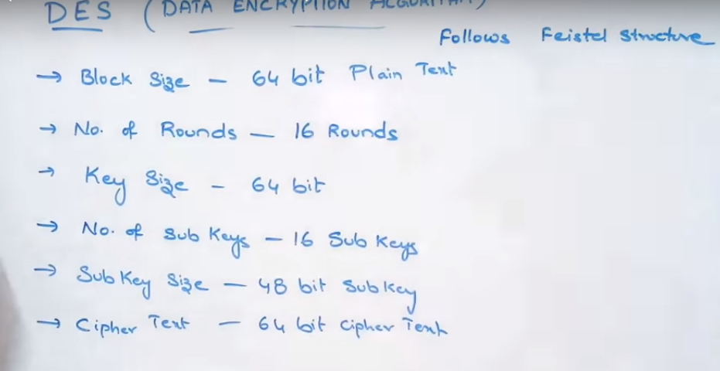

Slide 2
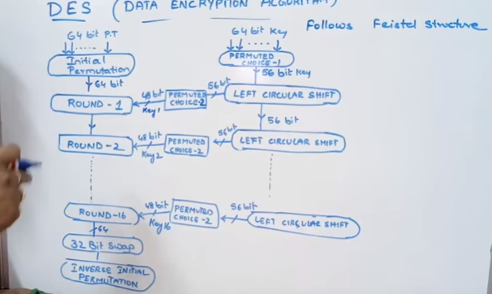

Slide 3
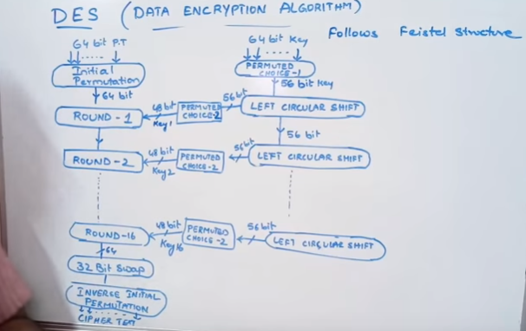

Slide 4
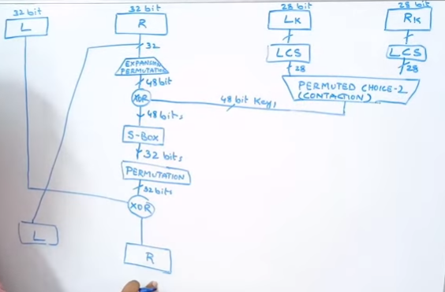
Round 1:

Slide 5
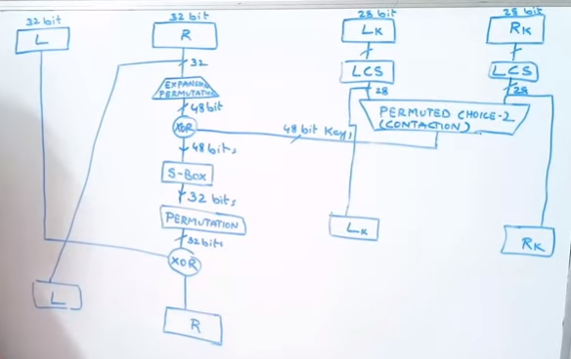
I/P for next key generation:

Slide 6
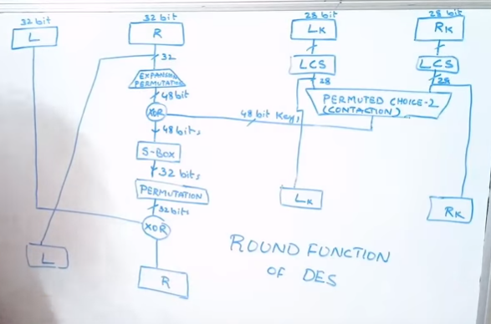

Slide 7
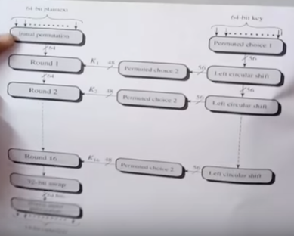

Slide 8
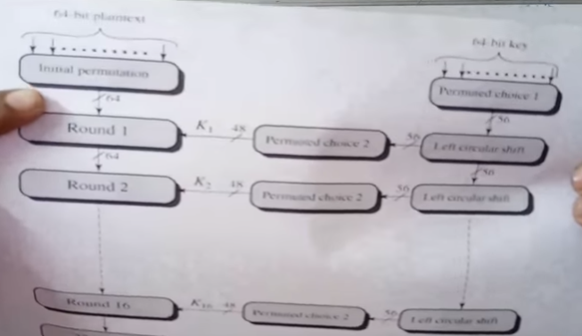

Slide 9
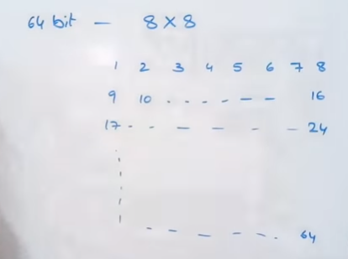
64 bit PT represented as 8X8 matrix:

Slide 10
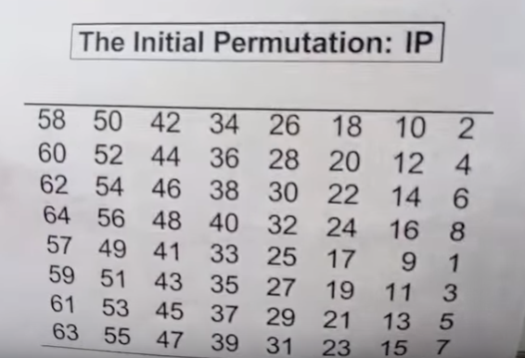

Slide 11
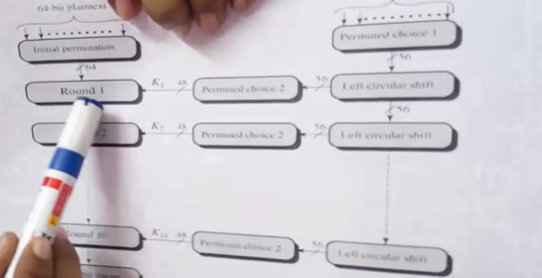
O/P OF I.P To ROUND1:

Slide 12
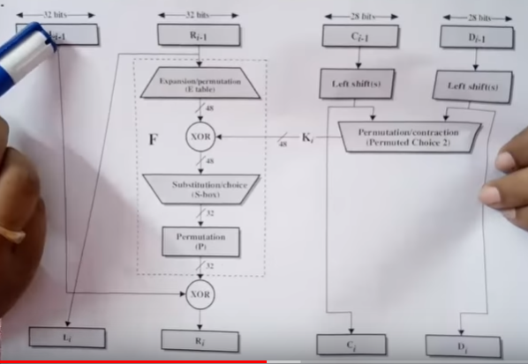
Round1:

Slide 13
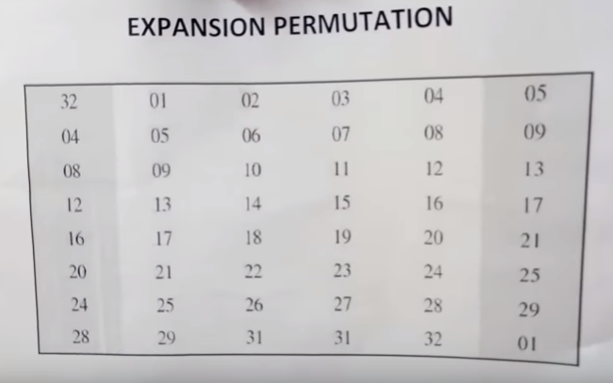
i/p: 32 bit & o/p: 48 bit Adding 1&6 Column

Slide 14
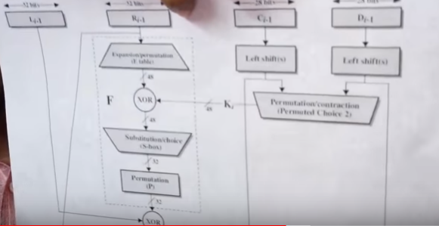
Next Step: Permitted Choice2

Slide 15
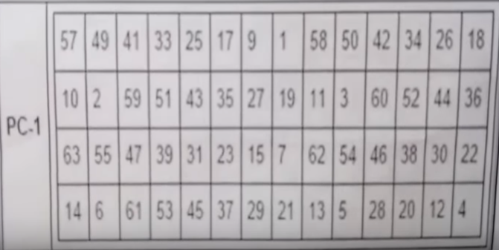
Eliminate multiples of 8 in PC-1 I/P: 64 bit O/P:56 bit

Slide 16
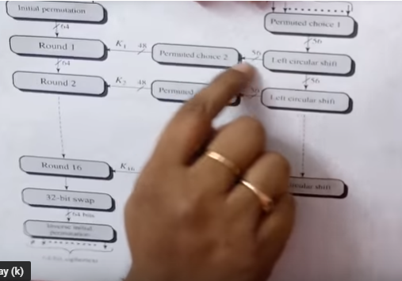
Left circular shift

Slide 17
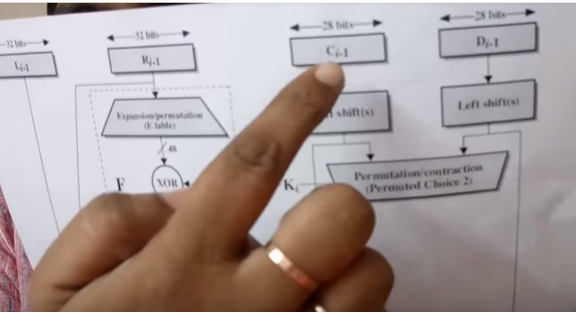
Two halves each 28 bit L& R

Slide 18
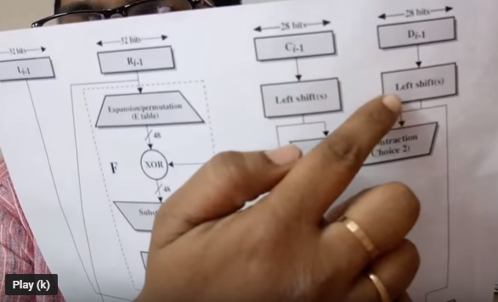
Left shift

Slide 19
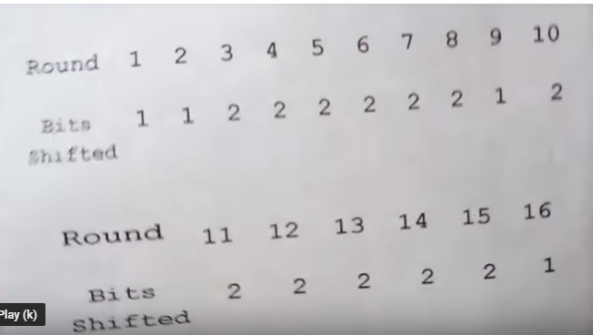
No of bits shifts depends on Round No

Slide 20
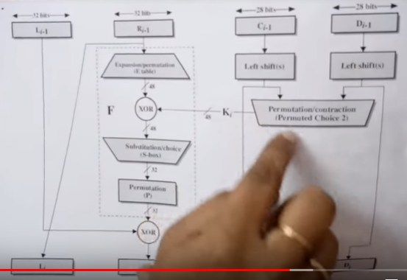
PC-2

Slide 21
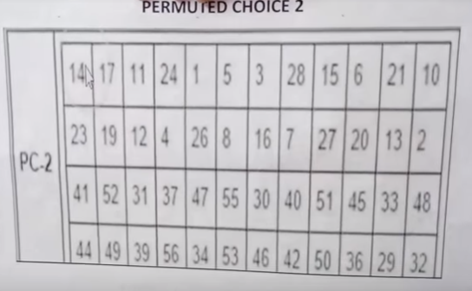
PC-2: 56 Bit key is reduced to 48 bit

Slide 22
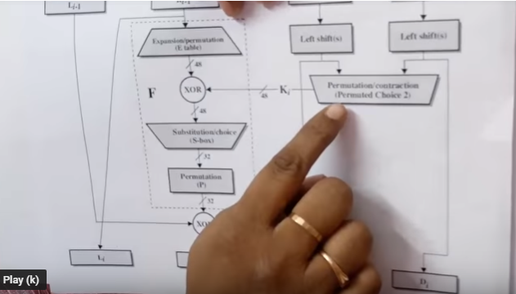
O/p of PC-2 EX-OR with EP

Slide 23
In S-box 48 bit is reduced to 32 bit

Slide 24
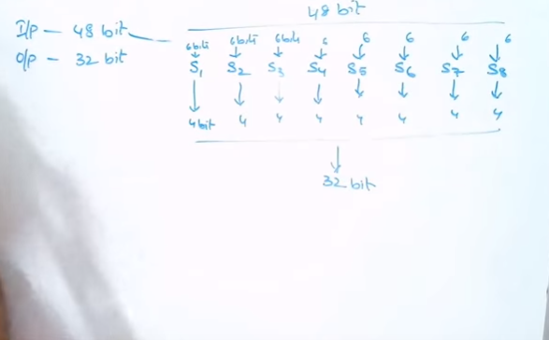
Each S-box 6 bit I/P and 4 bit O/P

Slide 25
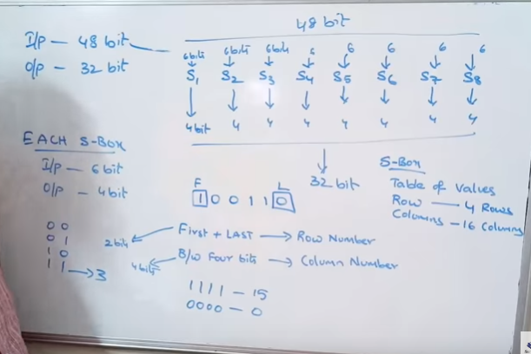
S-Box: 4 Rows & 16 Colums

Slide 26
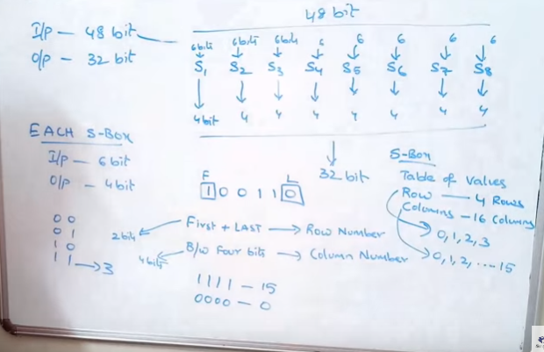

Slide 27
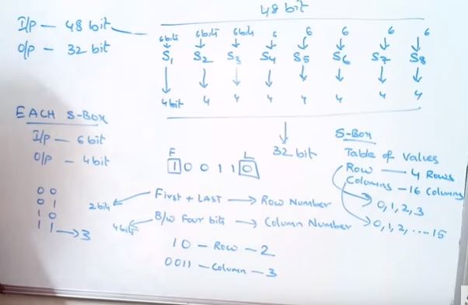
Row 2 & Column 3: i.e 8

Slide 28
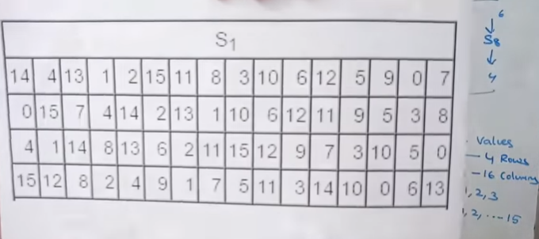
Sample S-box: S1

Slide 29
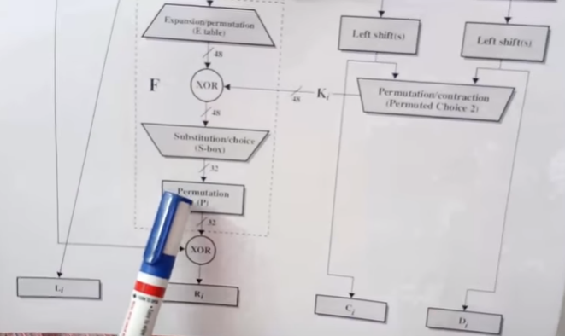
Then Permutation:

Slide 30
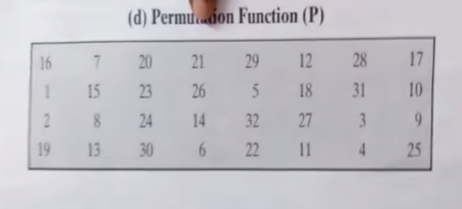
Permutation for Transposition order: Re arrangement will be done

Slide 31
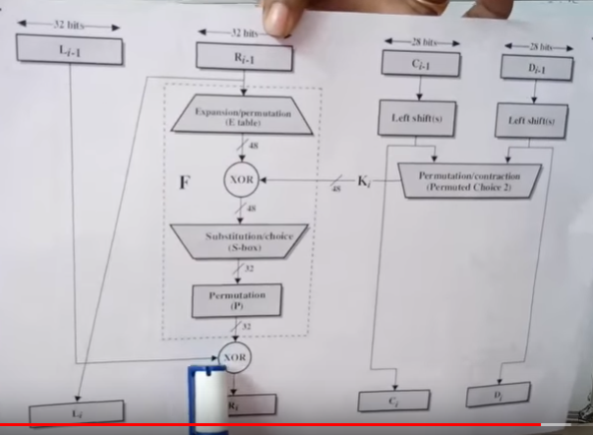
Ex-or Operation with left half:

Slide 32
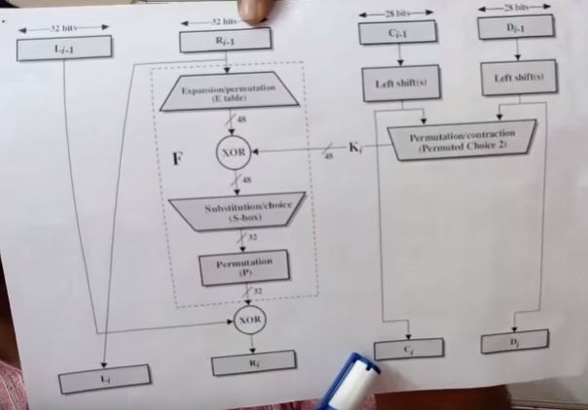
Keys: for next round

Slide 33
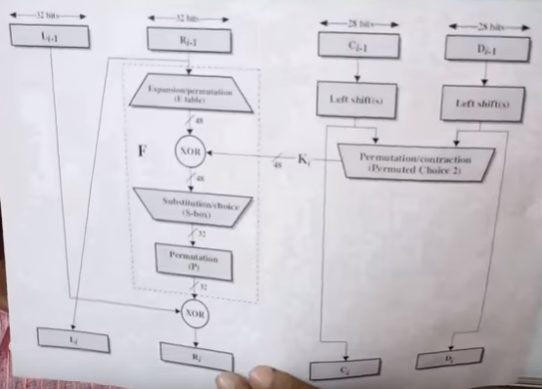
Single Round:

Slide 34
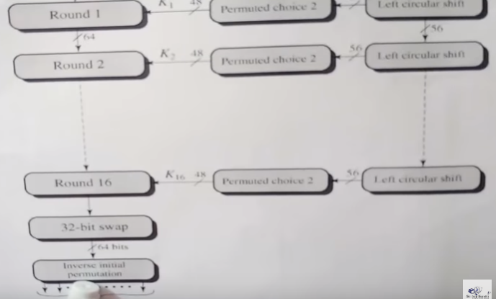
32 bit swap & Inverse initial permutation:

Slide 35
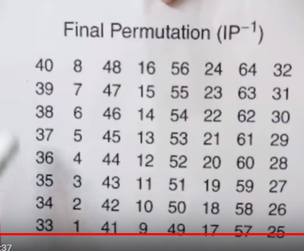
Inverse initial permutation: 64 bit I/P & 64 bit O/p

Slide 36
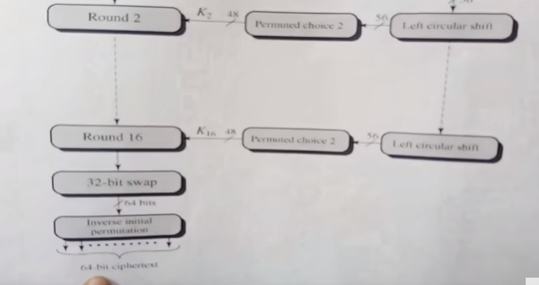
Cypher text:

